Slide 1
Trivia Night
2026-W38 · AB
Trivia Night · SAMPLE · no resale
Notes:
Trivia Night · SAMPLE · no resale
Trivia Night · SAMPLE · no resale

Slide 2
Canada (SAMPLE)
Sample round. Not approved for sale.
Trivia Night · SAMPLE · no resale
Notes:
About 10 minutes plus marking.
Trivia Night · SAMPLE · no resale

Slide 3
Canada (SAMPLE) · 1
Which national park in Alberta, established in 1885, was Canada's first?
Trivia Night · SAMPLE · no resale
Notes:
Answer: Banff National Park. Banff: BANF Trivia Night · SAMPLE · no resale
Trivia Night · SAMPLE · no resale

Slide 4
Canada (SAMPLE) · 1 — Answer
Banff National Park
Trivia Night · SAMPLE · no resale
Notes:
The park grew from a hot-springs reserve at Cave and Basin.
Trivia Night · SAMPLE · no resale

Slide 5
Canada (SAMPLE) · 2
Which Prime Minister introduced the Canada Pension Plan in 1965?
Trivia Night · SAMPLE · no resale
Notes:
Answer: Lester B. Pearson. Trivia Night · SAMPLE · no resale
Trivia Night · SAMPLE · no resale

Slide 6
Canada (SAMPLE) · 2 — Answer
Lester B. Pearson
Trivia Night · SAMPLE · no resale
Notes:
The CPP began paying retirement pensions in 1967.
Trivia Night · SAMPLE · no resale

Slide 7
Canada (SAMPLE) · 3
Which Canadian city hosted the 1976 Summer Olympic Games?
Trivia Night · SAMPLE · no resale
Notes:
Answer: Montreal. Montreal: mun-tree-AWL. Montréal: moh-ray-AL Trivia Night · SAMPLE · no resale
Trivia Night · SAMPLE · no resale

Slide 8
Canada (SAMPLE) · 3 — Answer
Montreal
Trivia Night · SAMPLE · no resale
Notes:
Nadia Comaneci scored the first perfect 10 in Olympic gymnastics in Montreal.
Trivia Night · SAMPLE · no resale

Slide 9
Canada (SAMPLE) · 4
The RCMP was formed in 1920 by merging which two mounted police forces?
Trivia Night · SAMPLE · no resale
Notes:
Answer: North-West Mounted Police and Dominion Police. Trivia Night · SAMPLE · no resale
Trivia Night · SAMPLE · no resale

Slide 10
Canada (SAMPLE) · 4 — Answer
North-West Mounted Police and Dominion Police
Trivia Night · SAMPLE · no resale
Notes:
The force was renamed the Royal Canadian Mounted Police in 1920.
Trivia Night · SAMPLE · no resale

Slide 11
Canada (SAMPLE) · 5
Which Canadian river is generally listed as the country's longest?
Trivia Night · SAMPLE · no resale
Notes:
Answer: Mackenzie River. Mackenzie: muh-KEN-zee. Dehcho: DEH-choh Trivia Night · SAMPLE · no resale
Trivia Night · SAMPLE · no resale

Slide 12
Canada (SAMPLE) · 5 — Answer
Mackenzie River
Trivia Night · SAMPLE · no resale
Notes:
The river system drains into the Beaufort Sea.
Trivia Night · SAMPLE · no resale

Slide 13
Canada (SAMPLE) · 6
What is the highest mountain in Canada?
Trivia Night · SAMPLE · no resale
Notes:
Answer: Mount Logan. Kluane: kloo-AH-nee Trivia Night · SAMPLE · no resale
Trivia Night · SAMPLE · no resale

Slide 14
Canada (SAMPLE) · 6 — Answer
Mount Logan
Trivia Night · SAMPLE · no resale
Notes:
Mount Logan rises in Kluane National Park and Reserve.
Trivia Night · SAMPLE · no resale

Slide 15
Canada (SAMPLE) · 7
Which Canadian physician invented basketball in 1891 while working in Massachusetts?
Trivia Night · SAMPLE · no resale
Notes:
Answer: James Naismith. Trivia Night · SAMPLE · no resale
Trivia Night · SAMPLE · no resale

Slide 16
Canada (SAMPLE) · 7 — Answer
James Naismith
Trivia Night · SAMPLE · no resale
Notes:
Naismith was born in Almonte, Ontario.
Trivia Night · SAMPLE · no resale

Slide 17
Canada (SAMPLE) · 8
In what year did the Canadian Charter of Rights and Freedoms come into force?
Trivia Night · SAMPLE · no resale
Notes:
Answer: 1982. Trivia Night · SAMPLE · no resale
Trivia Night · SAMPLE · no resale

Slide 18
Canada (SAMPLE) · 8 — Answer
1982
Trivia Night · SAMPLE · no resale
Notes:
The Charter is Part I of the Constitution Act, 1982.
Trivia Night · SAMPLE · no resale

Slide 19
Canada (SAMPLE) · 9
Who chaired the commission that wrote a 1967 report leading to federal official bilingualism?
Trivia Night · SAMPLE · no resale
Notes:
Answer: Andre Laurendeau and Davidson Dunton. Laurendeau: lor-ahn-DOH Trivia Night · SAMPLE · no resale
Trivia Night · SAMPLE · no resale

Slide 20
Canada (SAMPLE) · 9 — Answer
Andre Laurendeau and Davidson Dunton
Trivia Night · SAMPLE · no resale
Notes:
The commission is often called the Laurendeau-Dunton Commission.
Trivia Night · SAMPLE · no resale

Slide 21
Canada (SAMPLE) · 10
Which Canadian scientist won the 1923 Nobel Prize in Physiology or Medicine with J.J.R. Macleod for insulin?
Trivia Night · SAMPLE · no resale
Notes:
Answer: Frederick Banting. Trivia Night · SAMPLE · no resale
Trivia Night · SAMPLE · no resale

Slide 22
Canada (SAMPLE) · 10 — Answer
Frederick Banting
Trivia Night · SAMPLE · no resale
Notes:
Banting shared his prize money with Charles Best.
Trivia Night · SAMPLE · no resale

Slide 23
Home province or territory (SAMPLE)
Sample round. Not approved for sale.
Trivia Night · SAMPLE · no resale
Notes:
About 10 minutes plus marking.
Trivia Night · SAMPLE · no resale

Slide 24
Home province or territory (SAMPLE) · 1
What is the capital city of Alberta?
Trivia Night · SAMPLE · no resale
Notes:
Answer: Edmonton. Trivia Night · SAMPLE · no resale
Trivia Night · SAMPLE · no resale

Slide 25
Home province or territory (SAMPLE) · 1 — Answer
Edmonton
Trivia Night · SAMPLE · no resale
Notes:
The legislature building overlooks the North Saskatchewan River.
Trivia Night · SAMPLE · no resale

Slide 26
Home province or territory (SAMPLE) · 2
In what year did Alberta become a province?
Trivia Night · SAMPLE · no resale
Notes:
Answer: 1905. Trivia Night · SAMPLE · no resale
Trivia Night · SAMPLE · no resale

Slide 27
Home province or territory (SAMPLE) · 2 — Answer
1905
Trivia Night · SAMPLE · no resale
Notes:
Alberta and Saskatchewan were created on the same day.
Trivia Night · SAMPLE · no resale

Slide 28
Home province or territory (SAMPLE) · 3
Which national park, created in 1885, is Canada's first?
Trivia Night · SAMPLE · no resale
Notes:
Answer: Banff National Park. Trivia Night · SAMPLE · no resale
Trivia Night · SAMPLE · no resale

Slide 29
Home province or territory (SAMPLE) · 3 — Answer
Banff National Park
Trivia Night · SAMPLE · no resale
Notes:
It began as the Hot Springs Reserve at Cave and Basin.
Trivia Night · SAMPLE · no resale

Slide 30
Home province or territory (SAMPLE) · 4
What is the name of Edmonton's National Hockey League team?
Trivia Night · SAMPLE · no resale
Notes:
Answer: Oilers. Trivia Night · SAMPLE · no resale
Trivia Night · SAMPLE · no resale

Slide 31
Home province or territory (SAMPLE) · 4 — Answer
Oilers
Trivia Night · SAMPLE · no resale
Notes:
The club joined the NHL in 1979.
Trivia Night · SAMPLE · no resale

Slide 32
Home province or territory (SAMPLE) · 5
What is Alberta's official floral emblem?
Trivia Night · SAMPLE · no resale
Notes:
Answer: wild rose. Trivia Night · SAMPLE · no resale
Trivia Night · SAMPLE · no resale

Slide 33
Home province or territory (SAMPLE) · 5 — Answer
wild rose
Trivia Night · SAMPLE · no resale
Notes:
The wild rose was adopted in 1930.
Trivia Night · SAMPLE · no resale

Slide 34
Home province or territory (SAMPLE) · 6
Which river flows through downtown Calgary?
Trivia Night · SAMPLE · no resale
Notes:
Answer: Bow River. Trivia Night · SAMPLE · no resale
Trivia Night · SAMPLE · no resale

Slide 35
Home province or territory (SAMPLE) · 6 — Answer
Bow River
Trivia Night · SAMPLE · no resale
Notes:
The Elbow River meets the Bow near Fort Calgary.
Trivia Night · SAMPLE · no resale

Slide 36
Home province or territory (SAMPLE) · 7
Which UNESCO park in Alberta is known for Late Cretaceous dinosaur fossils?
Trivia Night · SAMPLE · no resale
Notes:
Answer: Dinosaur Provincial Park. Trivia Night · SAMPLE · no resale
Trivia Night · SAMPLE · no resale

Slide 37
Home province or territory (SAMPLE) · 7 — Answer
Dinosaur Provincial Park
Trivia Night · SAMPLE · no resale
Notes:
The park is in the Red Deer River badlands.
Trivia Night · SAMPLE · no resale

Slide 38
Home province or territory (SAMPLE) · 8
Head-Smashed-In Buffalo Jump is near which southern Alberta city?
Trivia Night · SAMPLE · no resale
Notes:
Answer: Fort Macleod. Macleod: muh-KLOWD Trivia Night · SAMPLE · no resale
Trivia Night · SAMPLE · no resale

Slide 39
Home province or territory (SAMPLE) · 8 — Answer
Fort Macleod
Trivia Night · SAMPLE · no resale
Notes:
The site is a UNESCO World Heritage property associated with the Blackfoot.
Trivia Night · SAMPLE · no resale

Slide 40
Home province or territory (SAMPLE) · 9
The Athabasca oil sands lie primarily in which regional municipality?
Trivia Night · SAMPLE · no resale
Notes:
Answer: Wood Buffalo. Athabasca: ath-uh-BASS-kuh Trivia Night · SAMPLE · no resale
Trivia Night · SAMPLE · no resale

Slide 41
Home province or territory (SAMPLE) · 9 — Answer
Wood Buffalo
Trivia Night · SAMPLE · no resale
Notes:
Fort McMurray is the region's main urban service area.
Trivia Night · SAMPLE · no resale

Slide 42
Home province or territory (SAMPLE) · 10
Which provincial historic site near Smoky Lake interprets a 19th-century fur-trade and mission settlement on the North Saskatchewan River?
Trivia Night · SAMPLE · no resale
Notes:
Answer: Victoria Settlement. Metis: may-TEE Trivia Night · SAMPLE · no resale
Trivia Night · SAMPLE · no resale

Slide 43
Home province or territory (SAMPLE) · 10 — Answer
Victoria Settlement
Trivia Night · SAMPLE · no resale
Notes:
The site preserves buildings from the 1860s and 1870s.
Trivia Night · SAMPLE · no resale

Slide 44
World (SAMPLE)
Sample round. Not approved for sale.
Trivia Night · SAMPLE · no resale
Notes:
About 10 minutes plus marking.
Trivia Night · SAMPLE · no resale

Slide 45
World (SAMPLE) · 1
Which strait separates the Iberian Peninsula from Morocco at the Mediterranean's western entrance?
Trivia Night · SAMPLE · no resale
Notes:
Answer: Strait of Gibraltar. Trivia Night · SAMPLE · no resale
Trivia Night · SAMPLE · no resale

Slide 46
World (SAMPLE) · 1 — Answer
Strait of Gibraltar
Trivia Night · SAMPLE · no resale
Notes:
The strait connects the Atlantic Ocean to the Mediterranean Sea.
Trivia Night · SAMPLE · no resale

Slide 47
World (SAMPLE) · 2
What is the capital of Ethiopia?
Trivia Night · SAMPLE · no resale
Notes:
Answer: Addis Ababa. Addis Ababa: AH-dis AB-uh-buh Trivia Night · SAMPLE · no resale
Trivia Night · SAMPLE · no resale

Slide 48
World (SAMPLE) · 2 — Answer
Addis Ababa
Trivia Night · SAMPLE · no resale
Notes:
Addis Ababa hosts the African Union headquarters.
Trivia Night · SAMPLE · no resale

Slide 49
World (SAMPLE) · 3
Which country has the largest land area in the world?
Trivia Night · SAMPLE · no resale
Notes:
Answer: Russia. Trivia Night · SAMPLE · no resale
Trivia Night · SAMPLE · no resale

Slide 50
World (SAMPLE) · 3 — Answer
Russia
Trivia Night · SAMPLE · no resale
Notes:
Russia spans eleven time zones.
Trivia Night · SAMPLE · no resale

Slide 51
World (SAMPLE) · 4
Which European city is the headquarters of the United Nations' International Court of Justice?
Trivia Night · SAMPLE · no resale
Notes:
Answer: The Hague. The Hague: the HAYG. Den Haag: den HAHKH Trivia Night · SAMPLE · no resale
Trivia Night · SAMPLE · no resale

Slide 52
World (SAMPLE) · 4 — Answer
The Hague
Trivia Night · SAMPLE · no resale
Notes:
The court sits in the Peace Palace.
Trivia Night · SAMPLE · no resale

Slide 53
World (SAMPLE) · 5
Which South American country has Portuguese as its official language?
Trivia Night · SAMPLE · no resale
Notes:
Answer: Brazil. Trivia Night · SAMPLE · no resale
Trivia Night · SAMPLE · no resale

Slide 54
World (SAMPLE) · 5 — Answer
Brazil
Trivia Night · SAMPLE · no resale
Notes:
Portuguese arrived with the 1500 landing claimed for Portugal.
Trivia Night · SAMPLE · no resale

Slide 55
World (SAMPLE) · 6
What is the SI unit of electric current?
Trivia Night · SAMPLE · no resale
Notes:
Answer: ampere. Trivia Night · SAMPLE · no resale
Trivia Night · SAMPLE · no resale

Slide 56
World (SAMPLE) · 6 — Answer
ampere
Trivia Night · SAMPLE · no resale
Notes:
The ampere is one of the seven SI base units.
Trivia Night · SAMPLE · no resale

Slide 57
World (SAMPLE) · 7
Which desert is the largest hot desert on Earth?
Trivia Night · SAMPLE · no resale
Notes:
Answer: Sahara. Sahara: suh-HAIR-uh Trivia Night · SAMPLE · no resale
Trivia Night · SAMPLE · no resale

Slide 58
World (SAMPLE) · 7 — Answer
Sahara
Trivia Night · SAMPLE · no resale
Notes:
Antarctica is larger if cold deserts are included.
Trivia Night · SAMPLE · no resale

Slide 59
World (SAMPLE) · 8
Who wrote the 1813 novel Pride and Prejudice?
Trivia Night · SAMPLE · no resale
Notes:
Answer: Jane Austen. Trivia Night · SAMPLE · no resale
Trivia Night · SAMPLE · no resale

Slide 60
World (SAMPLE) · 8 — Answer
Jane Austen
Trivia Night · SAMPLE · no resale
Notes:
The novel was published anonymously as 'By the Author of Sense and Sensibility'.
Trivia Night · SAMPLE · no resale

Slide 61
World (SAMPLE) · 9
Which planet in the solar system has the shortest year?
Trivia Night · SAMPLE · no resale
Notes:
Answer: Mercury. Trivia Night · SAMPLE · no resale
Trivia Night · SAMPLE · no resale

Slide 62
World (SAMPLE) · 9 — Answer
Mercury
Trivia Night · SAMPLE · no resale
Notes:
Mercury orbits the Sun in about 88 Earth days.
Trivia Night · SAMPLE · no resale

Slide 63
World (SAMPLE) · 10
The ancient city of Great Zimbabwe is in which present-day country?
Trivia Night · SAMPLE · no resale
Notes:
Answer: Zimbabwe. Zimbabwe: zim-BAHB-way Trivia Night · SAMPLE · no resale
Trivia Night · SAMPLE · no resale

Slide 64
World (SAMPLE) · 10 — Answer
Zimbabwe
Trivia Night · SAMPLE · no resale
Notes:
The stone ruins were a centre of a Shona state from about the 11th to 15th centuries.
Trivia Night · SAMPLE · no resale

Slide 65
Picture (SAMPLE)
Sample round. Not approved for sale.
Trivia Night · SAMPLE · no resale
Notes:
About 10 minutes plus marking.
Trivia Night · SAMPLE · no resale

Slide 66

Picture (SAMPLE) · 1
Identify this national flag.
Trivia Night · SAMPLE · no resale
Notes:
Answer: Canada. Trivia Night · SAMPLE · no resale
Trivia Night · SAMPLE · no resale

Slide 67
Picture (SAMPLE) · 1 — Answer
Canada
Trivia Night · SAMPLE · no resale
Notes:
The current flag was adopted in 1965.
Trivia Night · SAMPLE · no resale

Slide 68
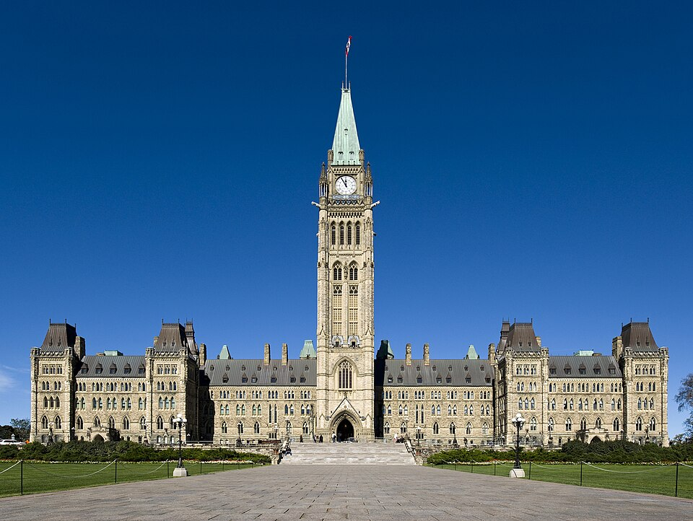
Picture (SAMPLE) · 2
Identify this Ottawa landmark with a tall central tower.
Trivia Night · SAMPLE · no resale
Notes:
Answer: Parliament Hill. Trivia Night · SAMPLE · no resale
Trivia Night · SAMPLE · no resale

Slide 69
Picture (SAMPLE) · 2 — Answer
Parliament Hill
Trivia Night · SAMPLE · no resale
Notes:
The Peace Tower commemorates the First World War.
Trivia Night · SAMPLE · no resale

Slide 70
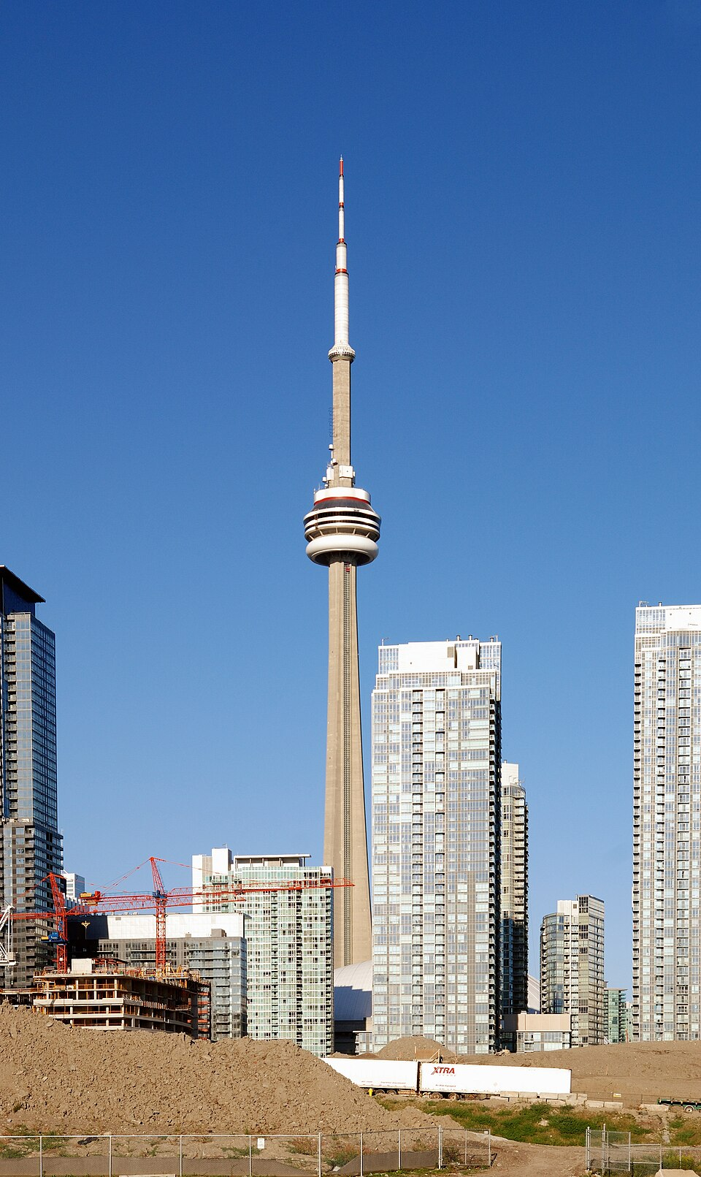
Picture (SAMPLE) · 3
Identify this Toronto tower.
Trivia Night · SAMPLE · no resale
Notes:
Answer: CN Tower. Trivia Night · SAMPLE · no resale
Trivia Night · SAMPLE · no resale

Slide 71
Picture (SAMPLE) · 3 — Answer
CN Tower
Trivia Night · SAMPLE · no resale
Notes:
The tower opened in 1976.
Trivia Night · SAMPLE · no resale

Slide 72
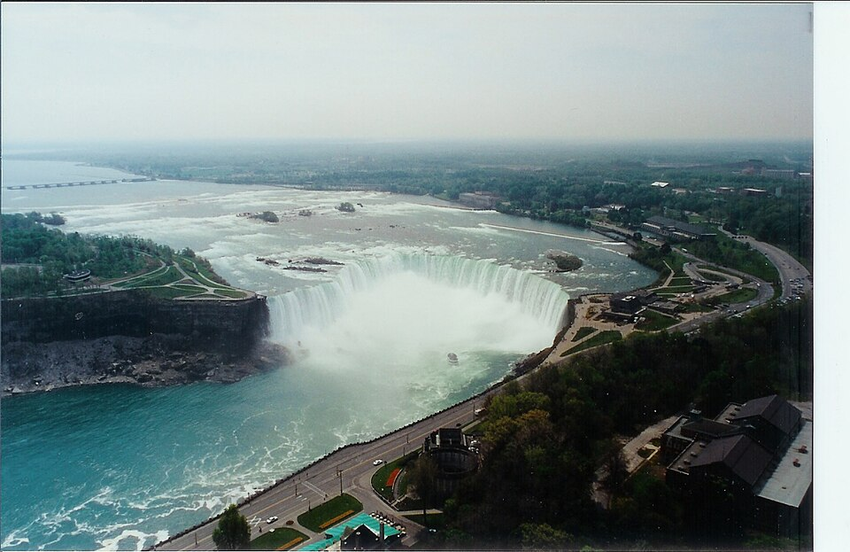
Picture (SAMPLE) · 4
Identify these waterfalls on the Canada-United States border.
Trivia Night · SAMPLE · no resale
Notes:
Answer: Niagara Falls. Niagara: nigh-AG-rah Trivia Night · SAMPLE · no resale
Trivia Night · SAMPLE · no resale

Slide 73
Picture (SAMPLE) · 4 — Answer
Niagara Falls
Trivia Night · SAMPLE · no resale
Notes:
Horseshoe Falls is the Canadian cataract of the Niagara River.
Trivia Night · SAMPLE · no resale

Slide 74

Picture (SAMPLE) · 5
Identify this national flag.
Trivia Night · SAMPLE · no resale
Notes:
Answer: France. Trivia Night · SAMPLE · no resale
Trivia Night · SAMPLE · no resale

Slide 75
Picture (SAMPLE) · 5 — Answer
France
Trivia Night · SAMPLE · no resale
Notes:
The vertical tricolour dates from the French Revolution.
Trivia Night · SAMPLE · no resale

Slide 76
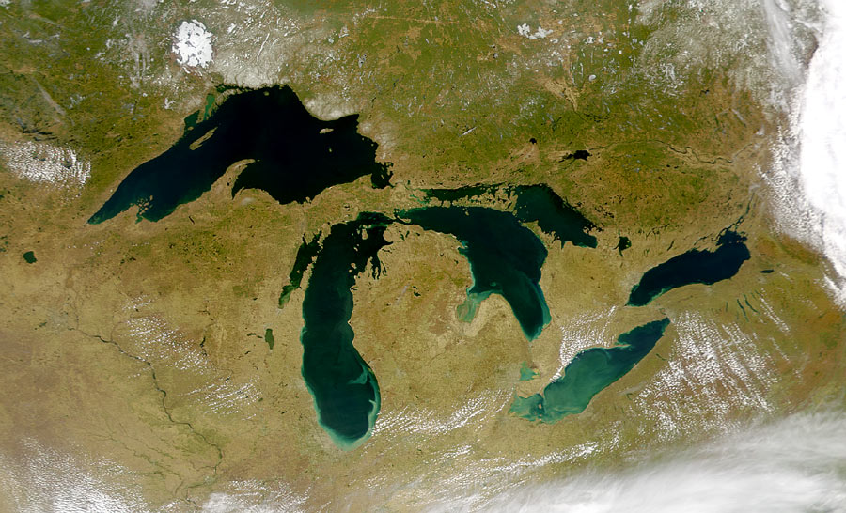
Picture (SAMPLE) · 6
Identify this group of five lakes on the Canada-United States border.
Trivia Night · SAMPLE · no resale
Notes:
Answer: Great Lakes. Trivia Night · SAMPLE · no resale
Trivia Night · SAMPLE · no resale

Slide 77
Picture (SAMPLE) · 6 — Answer
Great Lakes
Trivia Night · SAMPLE · no resale
Notes:
Lake Michigan is the only Great Lake entirely in the United States.
Trivia Night · SAMPLE · no resale

Slide 78
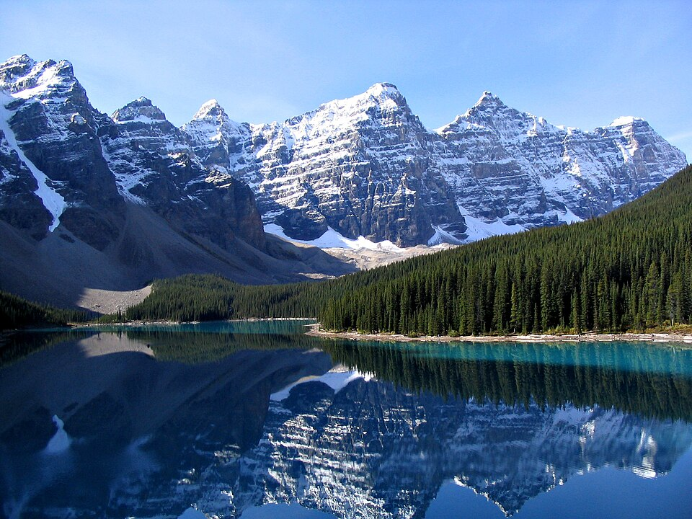
Picture (SAMPLE) · 7
Identify this Rocky Mountain national park in Alberta.
Trivia Night · SAMPLE · no resale
Notes:
Answer: Banff National Park. Trivia Night · SAMPLE · no resale
Trivia Night · SAMPLE · no resale

Slide 79
Picture (SAMPLE) · 7 — Answer
Banff National Park
Trivia Night · SAMPLE · no resale
Notes:
Banff was set aside in 1885 as Canada's first national park.
Trivia Night · SAMPLE · no resale

Slide 80
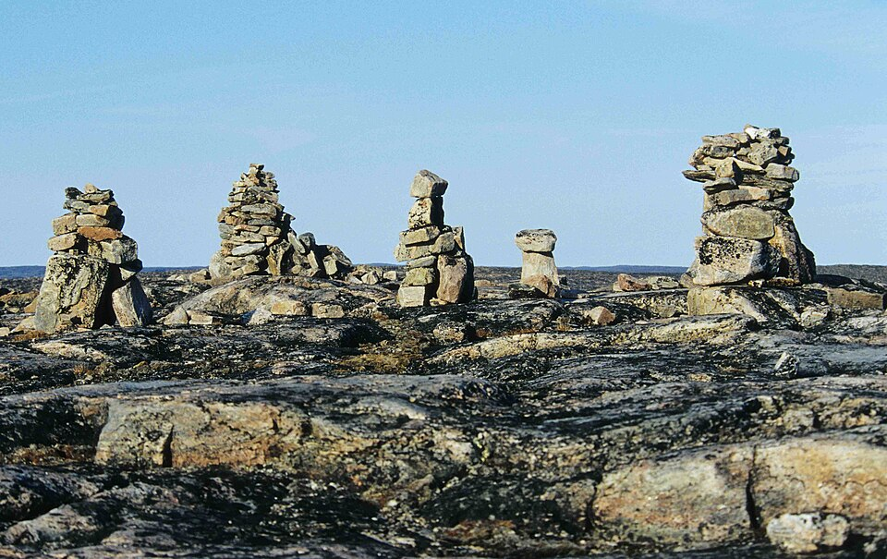
Picture (SAMPLE) · 8
Identify this stone landmark form used across Inuit Nunangat.
Trivia Night · SAMPLE · no resale
Notes:
Answer: inukshuk. inukshuk: in-OOK-shook. inuksuk: in-OOK-sook Trivia Night · SAMPLE · no resale
Trivia Night · SAMPLE · no resale

Slide 81
Picture (SAMPLE) · 8 — Answer
inukshuk
Trivia Night · SAMPLE · no resale
Notes:
An inuksuk can mark a route, a cache, or a gathering place.
Trivia Night · SAMPLE · no resale

Slide 82
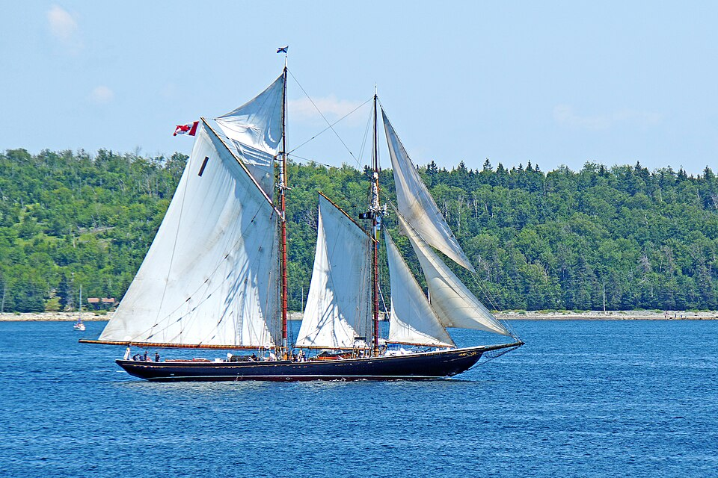
Picture (SAMPLE) · 9
Identify this famous Nova Scotia schooner.
Trivia Night · SAMPLE · no resale
Notes:
Answer: Bluenose. Trivia Night · SAMPLE · no resale
Trivia Night · SAMPLE · no resale

Slide 83
Picture (SAMPLE) · 9 — Answer
Bluenose
Trivia Night · SAMPLE · no resale
Notes:
Bluenose appears on the Canadian dime.
Trivia Night · SAMPLE · no resale

Slide 84

Picture (SAMPLE) · 10
Identify this organisation's flag.
Trivia Night · SAMPLE · no resale
Notes:
Answer: United Nations. Trivia Night · SAMPLE · no resale
Trivia Night · SAMPLE · no resale

Slide 85
Picture (SAMPLE) · 10 — Answer
United Nations
Trivia Night · SAMPLE · no resale
Notes:
The olive branches are a symbol of peace.
Trivia Night · SAMPLE · no resale

Slide 86
Entertainment and sport (SAMPLE)
Sample round. Not approved for sale.
Trivia Night · SAMPLE · no resale
Notes:
About 10 minutes plus marking.
Trivia Night · SAMPLE · no resale

Slide 87
Entertainment and sport (SAMPLE) · 1
Which CBC comedy series set in the fictional town of Schitt's Creek won nine Emmy Awards in 2020?
Trivia Night · SAMPLE · no resale
Notes:
Answer: Schitt's Creek. Trivia Night · SAMPLE · no resale
Trivia Night · SAMPLE · no resale

Slide 88
Entertainment and sport (SAMPLE) · 1 — Answer
Schitt's Creek
Trivia Night · SAMPLE · no resale
Notes:
The series ended its run with a sweep at the 72nd Primetime Emmy Awards.
Trivia Night · SAMPLE · no resale

Slide 89
Entertainment and sport (SAMPLE) · 2
Which Denys Arcand film won the 2004 Academy Award for Best International Feature Film?
Trivia Night · SAMPLE · no resale
Notes:
Answer: The Barbarian Invasions. Trivia Night · SAMPLE · no resale
Trivia Night · SAMPLE · no resale

Slide 90
Entertainment and sport (SAMPLE) · 2 — Answer
The Barbarian Invasions
Trivia Night · SAMPLE · no resale
Notes:
It was a sequel to Arcand's 1986 film The Decline of the American Empire.
Trivia Night · SAMPLE · no resale

Slide 91
Entertainment and sport (SAMPLE) · 3
Who recorded the 1970 song 'Snowbird', a major international hit written by Gene MacLellan?
Trivia Night · SAMPLE · no resale
Notes:
Answer: Anne Murray. Trivia Night · SAMPLE · no resale
Trivia Night · SAMPLE · no resale

Slide 92
Entertainment and sport (SAMPLE) · 3 — Answer
Anne Murray
Trivia Night · SAMPLE · no resale
Notes:
Murray was born in Springhill, Nova Scotia.
Trivia Night · SAMPLE · no resale

Slide 93
Entertainment and sport (SAMPLE) · 4
Which Montreal arena has been the home of the Canadiens since 1996?
Trivia Night · SAMPLE · no resale
Notes:
Answer: Bell Centre. Trivia Night · SAMPLE · no resale
Trivia Night · SAMPLE · no resale

Slide 94
Entertainment and sport (SAMPLE) · 4 — Answer
Bell Centre
Trivia Night · SAMPLE · no resale
Notes:
The arena opened as the Molson Centre in 1996.
Trivia Night · SAMPLE · no resale

Slide 95
Entertainment and sport (SAMPLE) · 5
Which Canadian comedy troupe launched SCTV?
Trivia Night · SAMPLE · no resale
Notes:
Answer: Second City. Trivia Night · SAMPLE · no resale
Trivia Night · SAMPLE · no resale

Slide 96
Entertainment and sport (SAMPLE) · 5 — Answer
Second City
Trivia Night · SAMPLE · no resale
Notes:
SCTV began in 1976.
Trivia Night · SAMPLE · no resale

Slide 97
Entertainment and sport (SAMPLE) · 6
How many players from one side are on the ice in a standard curling team, not counting the alternate?
Trivia Night · SAMPLE · no resale
Notes:
Answer: 4. Trivia Night · SAMPLE · no resale
Trivia Night · SAMPLE · no resale

Slide 98
Entertainment and sport (SAMPLE) · 6 — Answer
4
Trivia Night · SAMPLE · no resale
Notes:
The positions are lead, second, third or vice, and skip.
Trivia Night · SAMPLE · no resale

Slide 99
Entertainment and sport (SAMPLE) · 7
In what year did the Canadian Football League adopt its current name?
Trivia Night · SAMPLE · no resale
Notes:
Answer: 1958. Trivia Night · SAMPLE · no resale
Trivia Night · SAMPLE · no resale

Slide 100
Entertainment and sport (SAMPLE) · 7 — Answer
1958
Trivia Night · SAMPLE · no resale
Notes:
The league formed from a merger of the Interprovincial Rugby Football Union and the Western Interprovincial Football Union.
Trivia Night · SAMPLE · no resale

Slide 101
Entertainment and sport (SAMPLE) · 8
Which Toronto-born director made the films The Fly (1986) and Crash (1996)?
Trivia Night · SAMPLE · no resale
Notes:
Answer: David Cronenberg. Trivia Night · SAMPLE · no resale
Trivia Night · SAMPLE · no resale

Slide 102
Entertainment and sport (SAMPLE) · 8 — Answer
David Cronenberg
Trivia Night · SAMPLE · no resale
Notes:
Cronenberg also directed Videodrome (1983).
Trivia Night · SAMPLE · no resale

Slide 103
Entertainment and sport (SAMPLE) · 9
Which Canadian sprinter won 100-metre gold at the 1996 Atlanta Olympics?
Trivia Night · SAMPLE · no resale
Notes:
Answer: Donovan Bailey. Trivia Night · SAMPLE · no resale
Trivia Night · SAMPLE · no resale

Slide 104
Entertainment and sport (SAMPLE) · 9 — Answer
Donovan Bailey
Trivia Night · SAMPLE · no resale
Notes:
Bailey also anchored Canada's 4x100-metre gold in Atlanta.
Trivia Night · SAMPLE · no resale

Slide 105
Entertainment and sport (SAMPLE) · 10
What is the name of the CBC radio show hosted for decades by Peter Gzowski that ended in 1997?
Trivia Night · SAMPLE · no resale
Notes:
Answer: Morningside. Gzowski: GOFF-skee Trivia Night · SAMPLE · no resale
Trivia Night · SAMPLE · no resale

Slide 106
Entertainment and sport (SAMPLE) · 10 — Answer
Morningside
Trivia Night · SAMPLE · no resale
Notes:
Gzowski's last Morningside broadcast was in May 1997.
Trivia Night · SAMPLE · no resale

Slide 107
Current events (SAMPLE)
Sample round. Not approved for sale.
Trivia Night · SAMPLE · no resale
Notes:
About 10 minutes plus marking.
Trivia Night · SAMPLE · no resale

Slide 108
Current events (SAMPLE) · 1
On 16 September 2026, Canada applied to join which UK-led military partnership of NATO members?
Trivia Night · SAMPLE · no resale
Notes:
Answer: Joint Expeditionary Force. Trivia Night · SAMPLE · no resale
Trivia Night · SAMPLE · no resale

Slide 109
Current events (SAMPLE) · 1 — Answer
Joint Expeditionary Force
Trivia Night · SAMPLE · no resale
Notes:
The JEF is a rapid-response partnership of European NATO members hosted by the United Kingdom.
Trivia Night · SAMPLE · no resale

Slide 110
Current events (SAMPLE) · 2
According to Reuters on 8 September 2026, Canada's retaliatory tariffs took effect after trade talks stalled with which country?
Trivia Night · SAMPLE · no resale
Notes:
Answer: United States. Trivia Night · SAMPLE · no resale
Trivia Night · SAMPLE · no resale

Slide 111
Current events (SAMPLE) · 2 — Answer
United States
Trivia Night · SAMPLE · no resale
Notes:
The report described counter-tariffs on selected U.S. goods.
Trivia Night · SAMPLE · no resale

Slide 112
Current events (SAMPLE) · 3
The Joint Expeditionary Force that Canada applied to join in September 2026 is hosted by which country?
Trivia Night · SAMPLE · no resale
Notes:
Answer: United Kingdom. Trivia Night · SAMPLE · no resale
Trivia Night · SAMPLE · no resale

Slide 113
Current events (SAMPLE) · 3 — Answer
United Kingdom
Trivia Night · SAMPLE · no resale
Notes:
The JEF is a rapid-response partnership of European NATO members.
Trivia Night · SAMPLE · no resale

Slide 114
Current events (SAMPLE) · 4
According to the 14 September 2026 Reuters report on Carney's investor summit, the meetings took place in which Canadian province?
Trivia Night · SAMPLE · no resale
Notes:
Answer: Ontario. Trivia Night · SAMPLE · no resale
Trivia Night · SAMPLE · no resale

Slide 115
Current events (SAMPLE) · 4 — Answer
Ontario
Trivia Night · SAMPLE · no resale
Notes:
The summit welcomed global investment leaders to Toronto.
Trivia Night · SAMPLE · no resale

Slide 116
Current events (SAMPLE) · 5
On 5 September 2026, which federal agency released the August 2026 Labour Force Survey?
Trivia Night · SAMPLE · no resale
Notes:
Answer: Statistics Canada. Trivia Night · SAMPLE · no resale
Trivia Night · SAMPLE · no resale

Slide 117
Current events (SAMPLE) · 5 — Answer
Statistics Canada
Trivia Night · SAMPLE · no resale
Notes:
The Labour Force Survey is Canada's primary monthly jobs report.
Trivia Night · SAMPLE · no resale

Slide 118
Current events (SAMPLE) · 6
According to a 14 September 2026 Reuters report, in which Canadian city did the Prime Minister host a two-day investor summit that week?
Trivia Night · SAMPLE · no resale
Notes:
Answer: Toronto. Trivia Night · SAMPLE · no resale
Trivia Night · SAMPLE · no resale

Slide 119
Current events (SAMPLE) · 6 — Answer
Toronto
Trivia Night · SAMPLE · no resale
Notes:
The report described a two-day summit beginning that Monday.
Trivia Night · SAMPLE · no resale

Slide 120
Current events (SAMPLE) · 7
In September 2026, the European Central Bank left its main refinancing rate unchanged. In which city is the ECB headquartered?
Trivia Night · SAMPLE · no resale
Notes:
Answer: Frankfurt. Frankfurt: FRANK-furt Trivia Night · SAMPLE · no resale
Trivia Night · SAMPLE · no resale

Slide 121
Current events (SAMPLE) · 7 — Answer
Frankfurt
Trivia Night · SAMPLE · no resale
Notes:
The ECB moved into its Frankfurt skyscraper in 2014.
Trivia Night · SAMPLE · no resale

Slide 122
Current events (SAMPLE) · 8
According to a 12 September 2026 Reuters report, which Canadian airline warned of flight disruptions during a labour dispute that week?
Trivia Night · SAMPLE · no resale
Notes:
Answer: Air Canada. Trivia Night · SAMPLE · no resale
Trivia Night · SAMPLE · no resale

Slide 123
Current events (SAMPLE) · 8 — Answer
Air Canada
Trivia Night · SAMPLE · no resale
Notes:
Confirm operational status on the carrier's travel advisory before approval.
Trivia Night · SAMPLE · no resale

Slide 124
Current events (SAMPLE) · 9
On 10 September 2026, NASA and the Canadian Space Agency announced a new astronaut class. Which Canadian agency partners with NASA on the Artemis program?
Trivia Night · SAMPLE · no resale
Notes:
Answer: Canadian Space Agency. Trivia Night · SAMPLE · no resale
Trivia Night · SAMPLE · no resale

Slide 125
Current events (SAMPLE) · 9 — Answer
Canadian Space Agency
Trivia Night · SAMPLE · no resale
Notes:
Canada provides the Canadarm3 robotics for the Gateway lunar outpost.
Trivia Night · SAMPLE · no resale

Slide 126
Current events (SAMPLE) · 10
According to a Reuters report on 8 September 2026, Canadian counter-tariffs covered about how many US dollars of US goods?
Trivia Night · SAMPLE · no resale
Notes:
Answer: 20 billion. Trivia Night · SAMPLE · no resale
Trivia Night · SAMPLE · no resale

Slide 127
Current events (SAMPLE) · 10 — Answer
20 billion
Trivia Night · SAMPLE · no resale
Notes:
Confirm the dollar figure on the official Government of Canada notice before any paid release.
Trivia Night · SAMPLE · no resale

Slide 128
Theme (SAMPLE)
Sample round. Not approved for sale.
Trivia Night · SAMPLE · no resale
Notes:
About 10 minutes plus marking.
Trivia Night · SAMPLE · no resale

Slide 129
Theme (SAMPLE) · 1
Which Canadian invented the telephone, receiving a US patent in 1876?
Trivia Night · SAMPLE · no resale
Notes:
Answer: Alexander Graham Bell. Trivia Night · SAMPLE · no resale
Trivia Night · SAMPLE · no resale

Slide 130
Theme (SAMPLE) · 1 — Answer
Alexander Graham Bell
Trivia Night · SAMPLE · no resale
Notes:
Bell did much of the work at his family home in Brantford, Ontario, and in Boston.
Trivia Night · SAMPLE · no resale

Slide 131
Theme (SAMPLE) · 2
What winter transport did Joseph-Armand Bombardier begin selling in 1937 as the B7?
Trivia Night · SAMPLE · no resale
Notes:
Answer: snowmobile. Bombardier: bom-bar-DYAY Trivia Night · SAMPLE · no resale
Trivia Night · SAMPLE · no resale

Slide 132
Theme (SAMPLE) · 2 — Answer
snowmobile
Trivia Night · SAMPLE · no resale
Notes:
The later Ski-Doo brand appeared in the late 1950s.
Trivia Night · SAMPLE · no resale

Slide 133
Theme (SAMPLE) · 3
What medical hormone did Banting, Best, Collip, and Macleod isolate in the early 1920s in Toronto?
Trivia Night · SAMPLE · no resale
Notes:
Answer: insulin. Trivia Night · SAMPLE · no resale
Trivia Night · SAMPLE · no resale

Slide 134
Theme (SAMPLE) · 3 — Answer
insulin
Trivia Night · SAMPLE · no resale
Notes:
The University of Toronto administered the patents.
Trivia Night · SAMPLE · no resale

Slide 135
Theme (SAMPLE) · 4
Which communication system did Reginald Fessenden demonstrate by transmitting voice by radio in 1906?
Trivia Night · SAMPLE · no resale
Notes:
Answer: voice radio. Fessenden: FESS-en-den Trivia Night · SAMPLE · no resale
Trivia Night · SAMPLE · no resale

Slide 136
Theme (SAMPLE) · 4 — Answer
voice radio
Trivia Night · SAMPLE · no resale
Notes:
Fessenden was born in East-Bolton, Quebec.
Trivia Night · SAMPLE · no resale

Slide 137
Theme (SAMPLE) · 5
Swedish-American engineer Gideon Sundback refined which garment fastening into the modern zipper while working in Ontario?
Trivia Night · SAMPLE · no resale
Notes:
Answer: zipper. Sundback: SUND-back Trivia Night · SAMPLE · no resale
Trivia Night · SAMPLE · no resale

Slide 138
Theme (SAMPLE) · 5 — Answer
zipper
Trivia Night · SAMPLE · no resale
Notes:
Sundback was born in Sweden and later worked at a factory in St. Catharines, Ontario.
Trivia Night · SAMPLE · no resale

Slide 139
Theme (SAMPLE) · 6
Which federal weather radio service broadcasts alerts on dedicated VHF frequencies across Canada?
Trivia Night · SAMPLE · no resale
Notes:
Answer: Weatheradio Canada. Trivia Night · SAMPLE · no resale
Trivia Night · SAMPLE · no resale

Slide 140
Theme (SAMPLE) · 6 — Answer
Weatheradio Canada
Trivia Night · SAMPLE · no resale
Notes:
Environment and Climate Change Canada operates the network.
Trivia Night · SAMPLE · no resale

Slide 141
Theme (SAMPLE) · 7
What clingy kitchen wrap became a North American household staple after polymer research at Canadian Union Carbide plants in the 1950s?
Trivia Night · SAMPLE · no resale
Notes:
Answer: Saran wrap. Trivia Night · SAMPLE · no resale
Trivia Night · SAMPLE · no resale

Slide 142
Theme (SAMPLE) · 7 — Answer
Saran wrap
Trivia Night · SAMPLE · no resale
Notes:
The Saran brand later passed to other companies, but the wrap style is still ubiquitous.
Trivia Night · SAMPLE · no resale

Slide 143
Theme (SAMPLE) · 8
Which electric wheelchair control system is associated with Canadian inventor George Klein after the Second World War?
Trivia Night · SAMPLE · no resale
Notes:
Answer: electric wheelchair. Trivia Night · SAMPLE · no resale
Trivia Night · SAMPLE · no resale

Slide 144
Theme (SAMPLE) · 8 — Answer
electric wheelchair
Trivia Night · SAMPLE · no resale
Notes:
Klein worked at the National Research Council.
Trivia Night · SAMPLE · no resale

Slide 145
Theme (SAMPLE) · 9
What goalie mask pioneer, a Montreal Canadiens player, is often credited with the first regularly used NHL mask in 1959?
Trivia Night · SAMPLE · no resale
Notes:
Answer: Jacques Plante. Jacques Plante: ZHAK PLAHNT Trivia Night · SAMPLE · no resale
Trivia Night · SAMPLE · no resale

Slide 146
Theme (SAMPLE) · 9 — Answer
Jacques Plante
Trivia Night · SAMPLE · no resale
Notes:
Plante returned to the ice wearing a fibreglass mask on 1 November 1959.
Trivia Night · SAMPLE · no resale

Slide 147
Theme (SAMPLE) · 10
Which instant mashed-potato product is associated with Canadian Edward Asselbergs' 1960s work at the Department of Agriculture?
Trivia Night · SAMPLE · no resale
Notes:
Answer: instant mashed potatoes. Asselbergs: ASS-el-bergs Trivia Night · SAMPLE · no resale
Trivia Night · SAMPLE · no resale

Slide 148
Theme (SAMPLE) · 10 — Answer
instant mashed potatoes
Trivia Night · SAMPLE · no resale
Notes:
The process used cooked, dried potato flakes.
Trivia Night · SAMPLE · no resale

Slide 149
Final question (SAMPLE)
Sample round. Not approved for sale.
Trivia Night · SAMPLE · no resale
Notes:
One question.
Trivia Night · SAMPLE · no resale

Slide 150
Final question (SAMPLE) · 1
In what year did Nunavut become a Canadian territory?
Trivia Night · SAMPLE · no resale
Notes:
Answer: 1999. Nunavut: NOO-na-voot Trivia Night · SAMPLE · no resale
Trivia Night · SAMPLE · no resale

Slide 151
Final question (SAMPLE) · 1 — Answer
1999
Trivia Night · SAMPLE · no resale
Notes:
Nunavut was created on 1 April 1999.
Trivia Night · SAMPLE · no resale

Slide 152
Tiebreaker (SAMPLE)
Sample round. Not approved for sale.
Trivia Night · SAMPLE · no resale
Notes:
One question.
Trivia Night · SAMPLE · no resale

Slide 153
Tiebreaker (SAMPLE) · 1
According to Statistics Canada, what was Canada's total population at the 2021 Census?
Trivia Night · SAMPLE · no resale
Notes:
Answer: 36991585. Trivia Night · SAMPLE · no resale
Trivia Night · SAMPLE · no resale

Slide 154
Tiebreaker (SAMPLE) · 1 — Answer
36991585
Trivia Night · SAMPLE · no resale
Notes:
Statistics Canada published 36,991,585 as the 2021 Census of Population count.
Trivia Night · SAMPLE · no resale

Slide 155
Final wager
Teams wager up to their current score. Closest wins the tie-break card if needed.
Trivia Night · SAMPLE · no resale
Notes:
Trivia Night · SAMPLE · no resale
Trivia Night · SAMPLE · no resale

